Slide 1
Island Evolutionary Algorithm
Filip Gąciarz
Igor Ratajczyk
Dominik Żurek

Slide 2
Table of Contents
1. Implementation overview
2. Kubernetes
2. MongoDB
3. Dockerizing the algorithm
4. Spinning up Islands using Kubernetes API
5. Monitoring and observability
6. Possible extensions

Slide 3
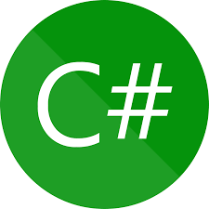
Algorithm implementation language – C#
Modern design
CRL
Multi-platform
Advanced null checking designs
.NET environment
Visual Studio
JIT
Well documented

Slide 4
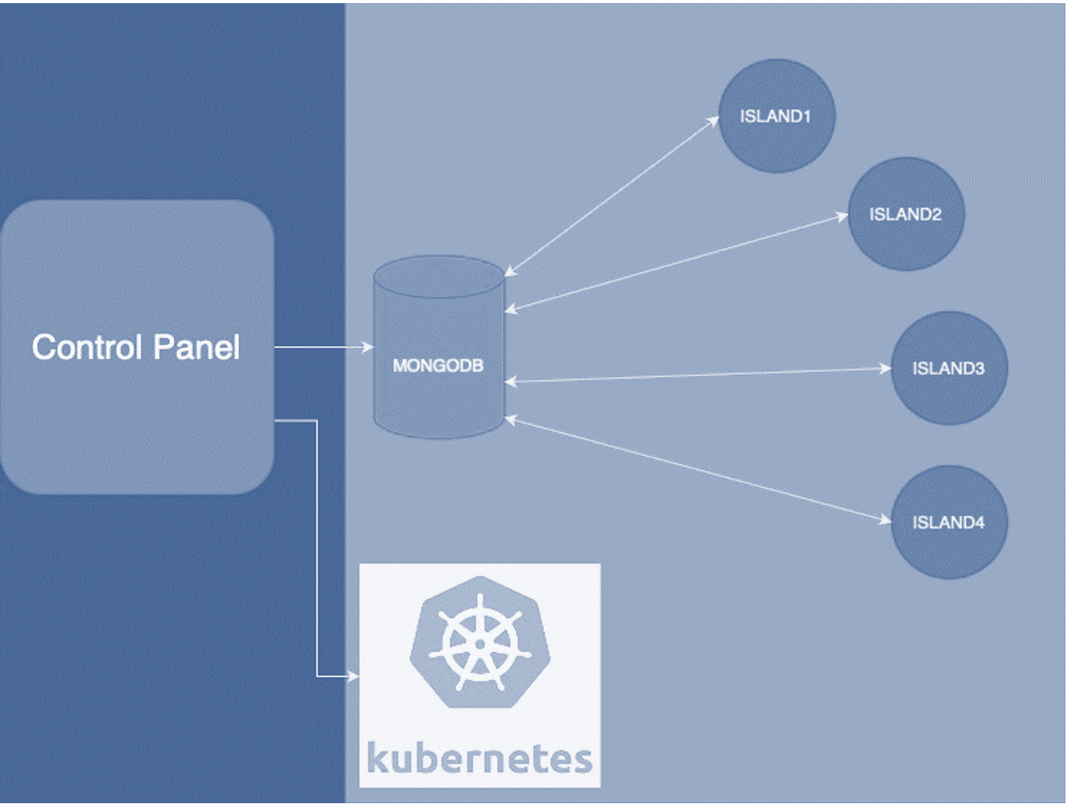
Islands Architecture

Slide 5
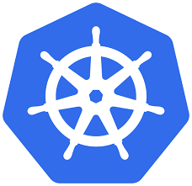
Why Kubernetes?
Engineered for production-grade distributed systems (i.e. deals with networking, storage orchestration, configuration management, self-healing capabilities).
Allows the IEA to scale both horizontally (more Islands) and veritacally (more resources per individual Island) without limits.

Slide 6
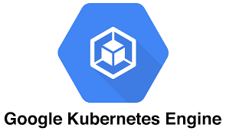
Creating a Kubernetes Cluster
Cluster is a set of nodes (group of machines) you can use to run containarized applications.
We use Google Cloud Platform, but the solution is cloud provider agnostic (on-premise is also possible).
The scalability of the algorithm is bounded only by our budget (and possible I/O bottlenecks).
Guaranteed high availability.

Slide 7

Why MongoDB?
The algorithm’s solutions are saved as JSON files.
MongoDB is a document-oriented database, which means it is a production-ready storage for JSON data (BSON to be exact).

Slide 8
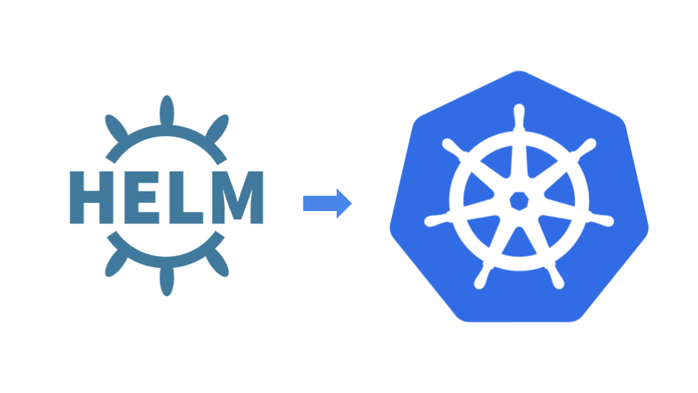
Installing MongoDB with Helm
Helm enables engineers to install complex systems on Kubernetes in a declarative and straightforward way.
We install MongoDB with it, since the managed MongoDB service on GCP is expensive.

Slide 9
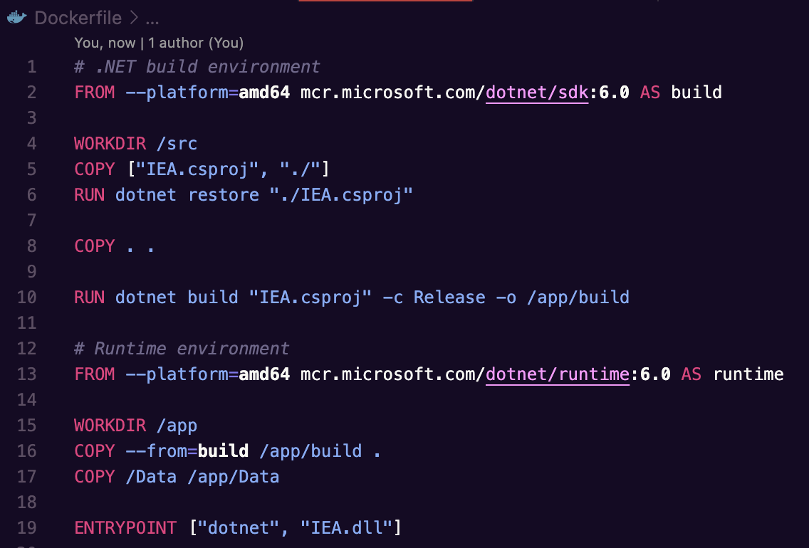
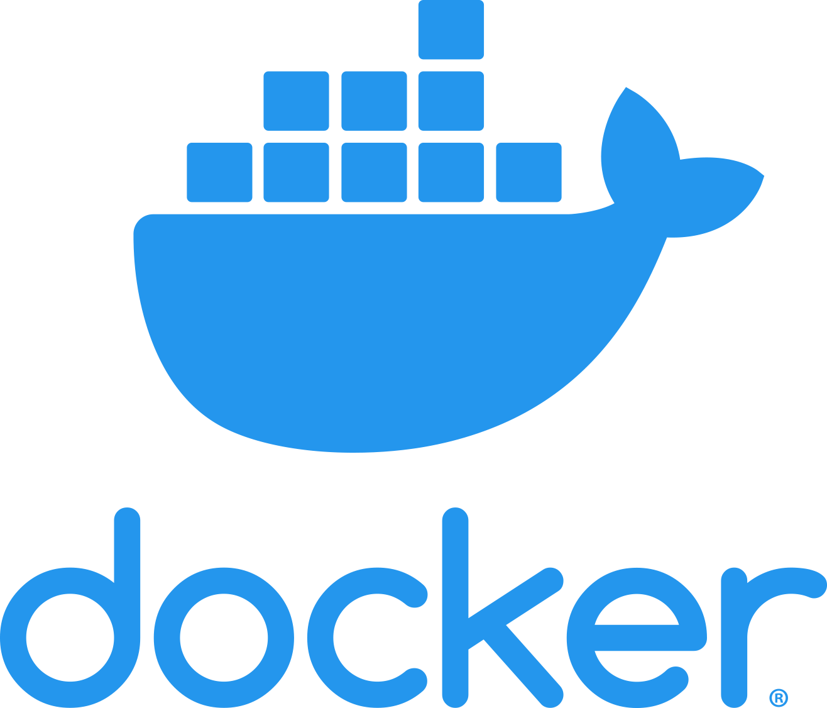
Dockerizing the algorithm
Docker packages apps & dependencies into containers, ensuring .NET apps run consistently across environments.

Slide 10
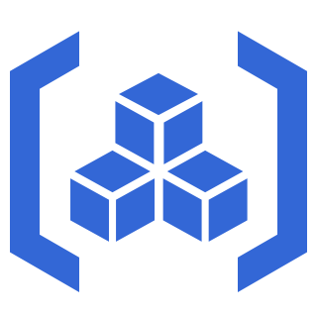
Pushing the Island’s image to a registry
Kubernetes when spinning up a container pulls images from registries (public or private).
We use a private registry on GCP to keep our secrets.
It also version controls every layer of the application’s image, but it doesn’t make a difference in our case (each change needs to be recompiled).

Slide 11
Spinning up Islands using Kubernetes API
Programmatically manage the number of running islands.
Each island is a Pod (group of containers) that uses the same algorithm image, but has different parameters injected as environment variables.
The parameters instruct each island on which ID to use for uploading solutions to the database and which ID to filter by when downloading solutions from the database.

Slide 12
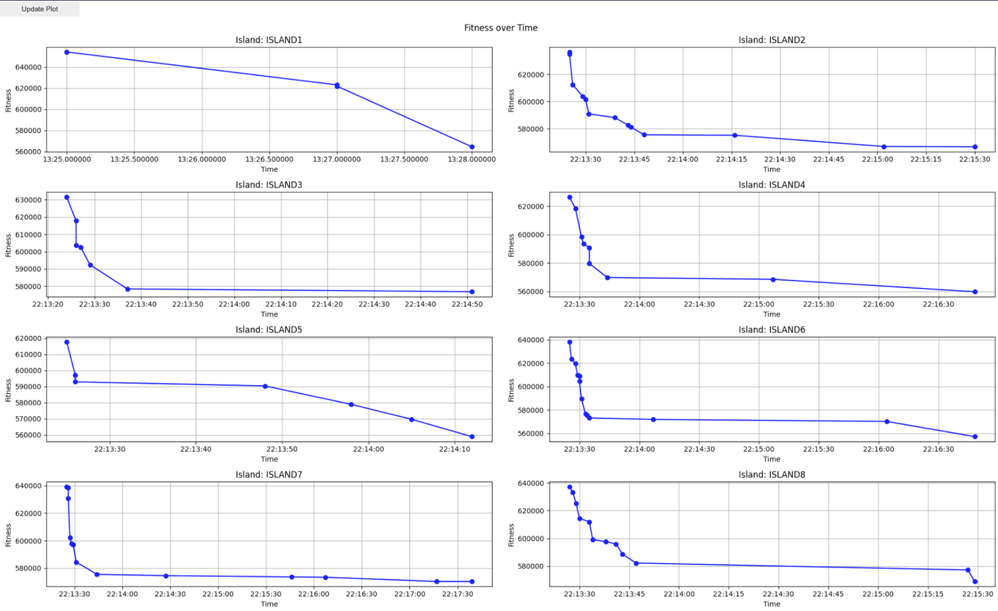
Monitoring the algorithm’s results

Slide 13
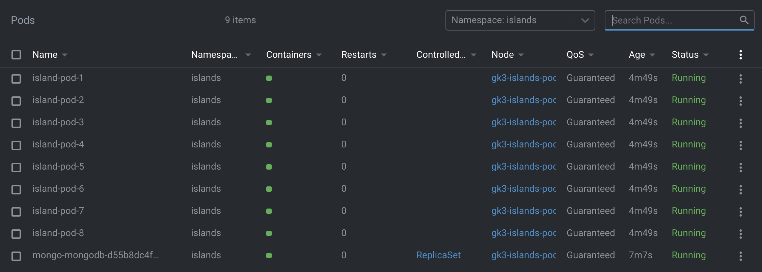
Monitoring Pods

Slide 14
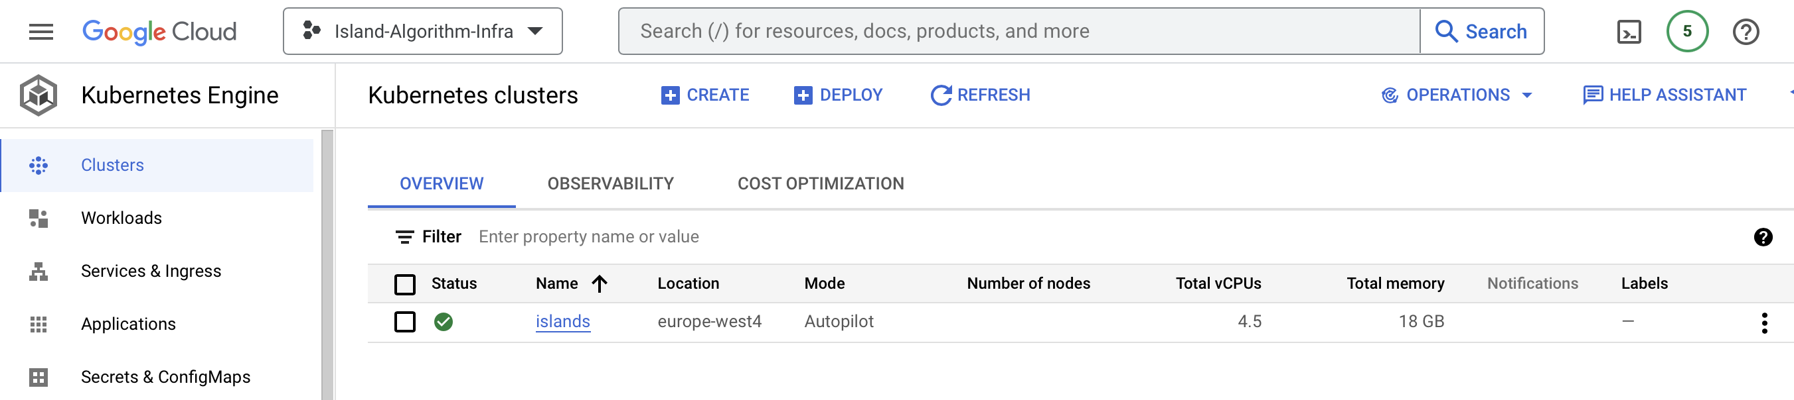
Monitoring resource consumption

Slide 15

More details
For a detailed guide on how to deploy our Islands Evolutionary Algorithm please see the README.md file inside the deployments directory.

Slide 16
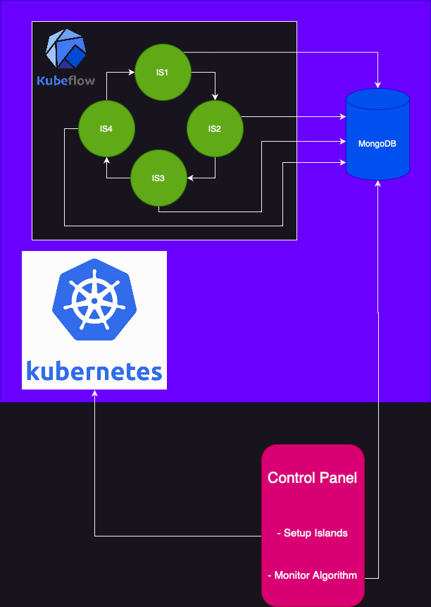
Possible future work
Use Message Passing Interface for migrating solutions between islands
Ring Topology
Asynchronous DB requests
High Performance Computing at its finest

